Slide 1

Support Vector Machine,Naiives and Decision Tree Model
Prod: Danielle Chevers - 100779457
Prof: Aruna Dorai

Slide 2

Analysis
John Hughes would like to see which algorithm to use to determine which model would work with his dataset. We will be analyzing which would provide a better accuracy and how we can improve the model selected with possible recommendations.

Slide 3
SVM
Supervised Machine Learning Algorithm is used for classification and/or regression.
It is more preferred for classification but is sometimes very useful for regression as well.
SVM finds a hyper-plane that creates a boundary between the types of data. This hyper-plane is nothing but a line in a two-dimensional space.
STEPS : we plot each data item in the dataset in an N-dimensional space, where N is the number of features/attributes in the data. Next, find the optimal hyperplane to separate the data.

Slide 4
Support Vector Machine
Advantages
Disadvantages
They perform very well on a range of datasets.
They are versatile : different kernel functions can be specified, or custom kernels can also be defined for specific datatypes.
They work well for both high and low dimensional data.
Efficiency (running time and memory usage) decreases as size of training set increases.
Needs careful normalization of input data and parameter tuning.
Does not provide direct probability estimator.
Difficult to interpret why a prediction was made.

Slide 5


Decision Tree
Decision Tree is a very popular machine learning algorithm. Decision Tree solves the problem of machine learning by transforming the data into a tree representation.
A decision tree algorithm can be used to solve both regression and classification problems.
Are popular among non-statisticians as they produce a model that is very easy to interpret. Each leaf node is presented as an if/then rule. Cases that satisfy the if/then statement are placed in the node.
Can handle data of different types, including continuous, categorical, ordinal, and binary. Transformations of the data are not required.
Can be useful for detecting important variables, interactions, and identifying outliers.
Handle missing data by identifying surrogate splits in the modeling process. Surrogate splits are splits highly associated with the primary split. In other models, records with missing values are omitted by default.

Slide 6
Decision Tree
Advantages
Disadvantages
Compared to other algorithms decision trees requires less effort for data preparation during pre-processing.
A decision tree does not require normalization of data.
A decision tree does not require scaling of data as well.
Missing values in the data also do NOT affect the process of building a decision tree to any considerable extent.
A Decision tree model is very intuitive and easy to explain to technical teams as well as stakeholders.
A small change in the data can cause a large change in the structure of the decision tree causing instability.
For a Decision tree sometimes, calculation can go far more complex compared to other algorithms.
Decision tree often involves higher time to train the model.
Decision tree training is relatively expensive as the complexity and time has taken are more.
The Decision Tree algorithm is inadequate for applying regression and predicting continuous values.

Slide 7
Naiives Bayes
In statistics, naive Bayes classifiers are a family of simple "probabilistic classifiers" based on applying Bayes' theorem with strong (naïve) independence assumptions between the features
It is mainly used in text classification that includes a high-dimensional training dataset
Naïve Bayes Classifier is one of the simple and most effective Classification algorithms which helps in building the fast machine learning models that can make quick predictions.
There are three types of Naive Bayes Model:
Gaussian, Multinomial and Bernoulli

Slide 8
Naiives Bayes
Advantages
Disadvantages
This algorithm works very fast and can easily predict the class of a test dataset.
You can use it to solve multi-class prediction problems as it’s quite useful with them.
Naive Bayes classifier performs better than other models with less training data if the assumption of independence of features holds.
If you have categorical input variables, the Naive Bayes algorithm performs exceptionally well in comparison to numerical variables.
If your test data set has a categorical variable of a category that wasn’t present in the training data set, the Naive Bayes model will assign it zero probability and won’t be able to make any predictions in this regard. This phenomenon is called ‘Zero Frequency,’ and you’ll have to use a smoothing technique to solve this problem.
This algorithm is also notorious as a lousy estimator. So, you shouldn’t take the probability outputs of ‘predict_proba’ too seriously.
It assumes that all the features are independent. While it might sound great in theory, in real life, you’ll hardly find a set of independent features.

Slide 9
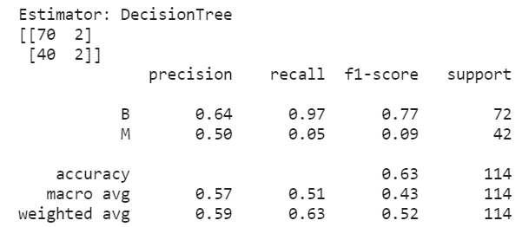
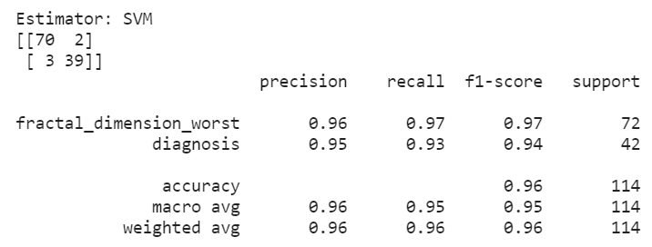
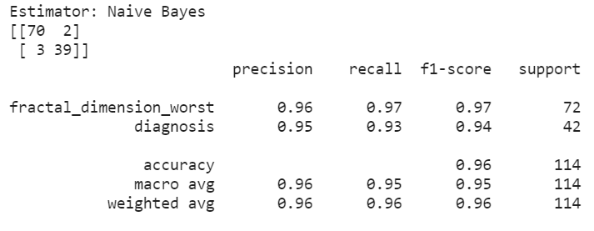
Algorithm Results
Decision Tree
Support Vector Machine
Naiive's Bayes

Slide 10
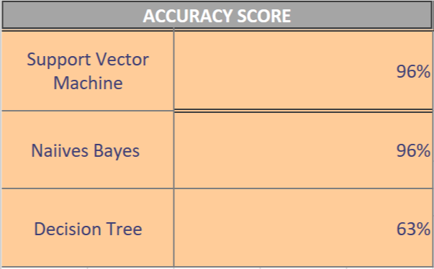
Results
As I ran both models, I was able to see that the best accuracy scores were Support Vector Machine and Naiive's Bayes.
In the SVM and Naiive's bayes model which were similar I was able to use 2 variables that were correlated to predict the accuracy.
Both models are comparable. It is great that we can always consider a variety of classifiers and compare the accuracy on which will be the better choice.
Either SVM model or Naiive’s will work out for John Hughes to use.

Slide 11

Recommendations
If I had to choose between the both models, I would select Support Vector Machine and possibly recommend the below with improving the model by:
Finding the most optimal C and gamma using grid search.
Finding the most discriminative feature using F-score.

Slide 12
REFERENCES
Javed, M. (2020, November 21). The best machine learning algorithm for handwritten Digits recognition. Retrieved April 07, 2021, from https://towardsdatascience.com/the-best-machine-learning-algorithm-for-handwritten-digits-recognition-2c6089ad8f09
K, D. (2020, December 26). Top 5 advantages and disadvantages of decision tree algorithm. Retrieved April 07, 2021, from https://dhirajkumarblog.medium.com/top-5-advantages-and-disadvantages-of-decision-tree-algorithm-428ebd199d9a
Introduction to support vector machines (svm). (2020, July 16). Retrieved April 07, 2021, from https://www.geeksforgeeks.org/introduction-to-support-vector-machines-svm/

